Slide 1

Lecture
on
“Advanced Computer Architecture –TCS 704”
by
Akansha Gupta
DEPARTMENT OF COMPUTER SCIENCE AND ENGINEERING
GRAPHIC ERA DEEMED TO BE UNIVERSITY – 248002

Slide 2
Moore's Law
- The law was named after Intel cofounder Gordon E. Moore - Moore's Law (published in an article April 19, 1965 in Electronics Magazine). - Moores Law is a computing term, which originated around the 1970's - Since the 1970s, the power of computers has doubled every year or and a half, yielding computers which are millions of times more powerful than their ancestors of a half century ago - The law states that processor speeds, or overall processing power for computers will double about every 18 month's - Deals with steady rate miniaturization of technology - Not Really a law + More a "Rule of Thumb" + A practical way to think about something - Different computer companies show that the term is not very popular but the rule is still accepted

Slide 3
What is meant by Moore's law ?
- It is specifically stated that the number of transistors on an affordable CPU would double about every 18 month's but more transistors is more accurate according to the prediction of Moore For Example: - Moore's Law means ever-more powerful personal computers for less and less money A computer chip that contained 2,000 transistors and cost $1,000 in 1970, $500 in 1972, $250 in 1974, and $0.97 in 1990 costs less than $0.02 to manufacture today A personal computer that cost $3,000 in 1990, $1,500 in 1992, and $750 in 1994 would now cost about $5 - The answer is that Moore's Law effectively means that approximately every two years personal computers and other electronic devices can do twice as many new, innovative, and unexpected things than before - Moore's Law makes it virtually certain that two or four or six or more years from now, we'll be doing more things we didn't expect to do with electronic devices. Some of those things will be absolutely new, without any traditional precedents - New things. New opportunities. New competitors. Old companies evolving or dying. New companies rising. A changing media landscape. If you think you've seen a lot change so far, you ain't seen nothing yet!

Slide 4
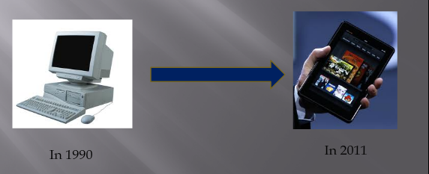
Advancements: - The contribution of Moore's Law has given rise to the reduction in the robust structure of devices to handy gadgets over these decades

Slide 5
Growth:
- The capabilities of many digital electronic devices are strongly linked to Moore's law: - Processing Speed, Memory capacity, sensors, and even the size of pixels in digital cameras - All of these are improving at (roughly) exponential rates. - The exponential improvement has dramatically enhanced the impact of digital electronics in nearly every segment of the world economy. - The exponential growth of Moore's Law will continue beyond the use of integrated circuits into technologies that will lead to technological singularity

Slide 6
The collapse of Moore's Law ?
Moores law is said to be breaking down, according to theoretical physicist Michio Kaku. He's talking about the so-called law that says the number of transistors that can be fit on a computer chip will double every 18 months, resulting in periodic increases in computing power. According to Kaku: "In about ten years or so, we will see the collapse of Moore's law. In fact all ready we see a slowing down of Moore's law. Computer power simply cannot maintain its rapid exponential rise using standard silicon technology". Intel Corporation has admitted this. Kaku says that when Moore's law finally collapse by the end of the next decade, we will simply tweak it a bit with chip-like computers in three dimensions. He then says "we may have to go to molecular computers and perhaps late in the 21st century quantum computers“.

Slide 7
The Future of Moore's Law:
Moore's Own Words: - "It can't continue forever" - Eventually miniaturization will lead to atomic level - At that point the law cannot be sustained - Still Valid for 10-20 years

Slide 8
Example:
Equation: Pn = Po x 2^n - Pn = computer processing power in future years - Po = computer processing power in the beginning year - n = number of years to develop a new microprocessor divided by 2 (ie. every two years) Example: In 1988, the number of transistors in the Intel 386 SX microprocessor was 275,000. What were the transistors counts of the Pentium II Intel microprocessor in 1997 ? Solution: If Intel doubles the number of transistors every two years, the new processor would have Pn = 275,000 x 2^n (where n = 9/2 = 4.5) = 275,000 x 22.63 = 6.2 million transistors

Slide 9
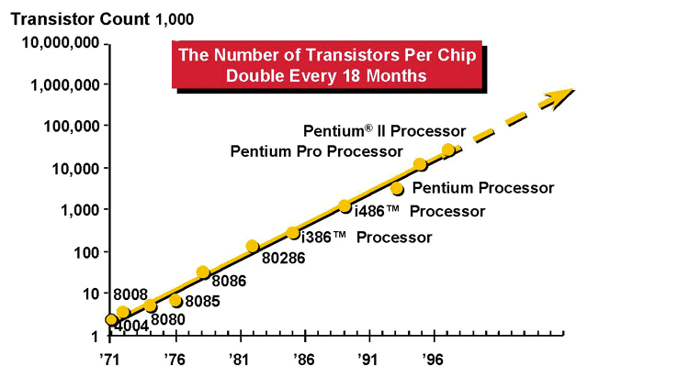
The charts below show the number of transistors per chip doubling every 18 months where the transistor count = 1,000. In the years since Moore's Law originated so 1970's into the late 1990's early 2000's

Slide 10
Classes of Parallelism and Parallel Architectures

Slide 11
Types of Parallelism
Parallelism in Hardware (Uniprocessor)
▪ Parallelism in a Uniprocessor
– Pipelining
– Superscalar, VLIW etc.
▪ SIMD instructions, Vector processors, GPUs
▪ Multiprocessor
– Symmetric shared
-memory multiprocessors
– Distributed
-memory multiprocessors
– Chip
-multiprocessors a.k.a. Multi-cores
▪ Multicomputers a.k.a. clusters
Parallelism in Software
▪ Instruction level parallelism
▪ Task-level parallelism
▪ Data parallelism
▪ Transaction level parallelism

Slide 12
Taxonomy of Parallel Computers
According to instruction and data streams (Flynn):
– Single instruction single data (SISD): this is the standard uniprocessor
– Single instruction, multiple data streams (SIMD):
▪ Same instruction is executed in all processors with different data
▪ E.g., Vector processors, SIMD instructions, GPUs
– Multiple instruction, single data streams (MISD):
▪ Different instructions on the same data
▪ Fault-tolerant computers, Near memory computing (Micron Automata processor).
– Multiple instruction, multiple data streams (MIMD): the “common” multiprocessor
▪ Each processor uses it own data and executes its own program
▪ Most flexible approach
▪ Easier/cheaper to build by putting together “off-the-shelf ” processors

Slide 13
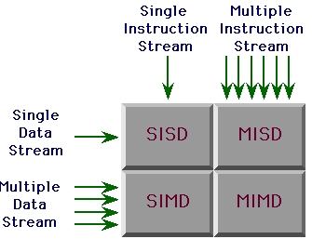
FLYNN’S CLASSIFICATION

Slide 14
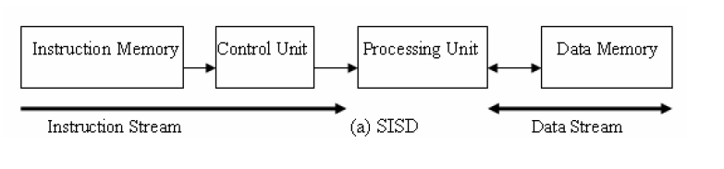
SISD
At one time, one instruction operates on one data
Traditional sequential architecture

Slide 15
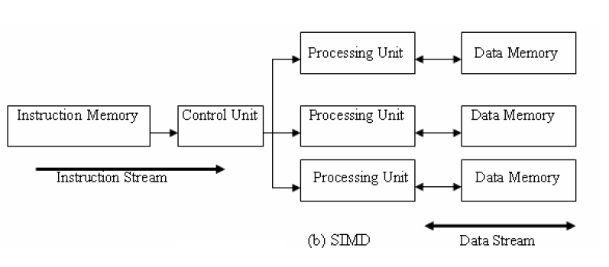
SIMD
At one time, one instruction operates on many data
Data parallel architecture
Vector architecture has similar characteristics, but achieve the parallelism with pipelining.
Array processors

Slide 16
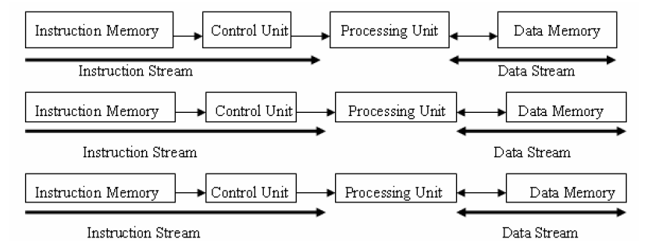
MIMD
Multiple instruction streams operating on multiple data streams
Classical distributed memory or SMP architectures

Slide 17
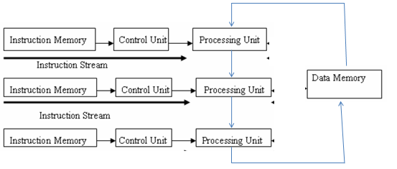
MISD machine
Not commonly seen.
Systolic array is one example of an MISD architecture.

Slide 18
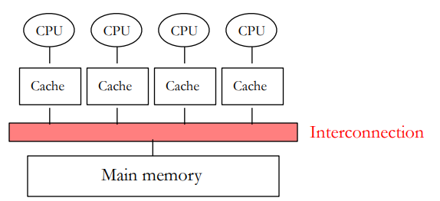
Taxonomy of Parallel Computers
According to physical organization of processors and memory:
– Physically centralized memory, uniform memory access (UMA)
▪ All memory is allocated at same distance from all processors
▪ Also called symmetric multiprocessors (SMP)
▪ Memory bandwidth is fixed and must accommodate all processors → does not scale to large number of processors
▪ Used in CMPs today (single-socket ones)

Slide 19
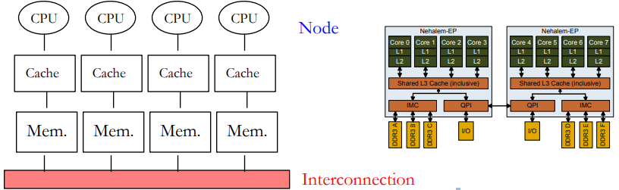
Taxonomy of Parallel Computers
According to physical organization of processors and memory:
– Physically distributed memory, non-uniform memory access (NUMA)
▪ A portion of memory is allocated with each processor (node)
▪ Accessing local memory is much faster than remote memory
▪ If most accesses are to local memory than overall memory bandwidth increases linearly with the number of processors
▪ Used in multi-socket CMPs E.g Intel Nehalem

Slide 20
https://youtu.be/XNdIoAHSoQk
THANKS

